Slide 1



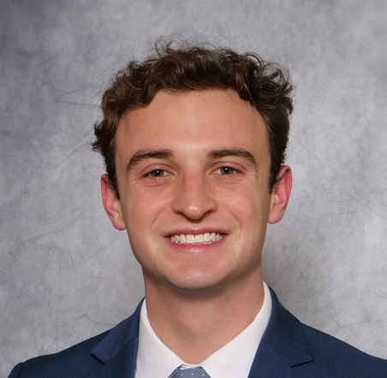
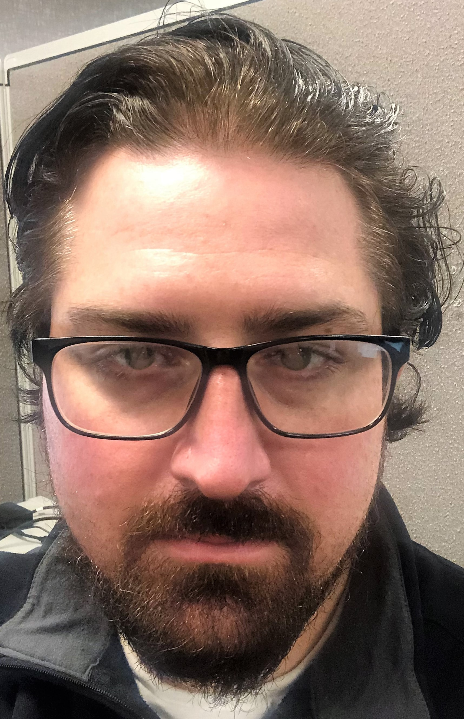
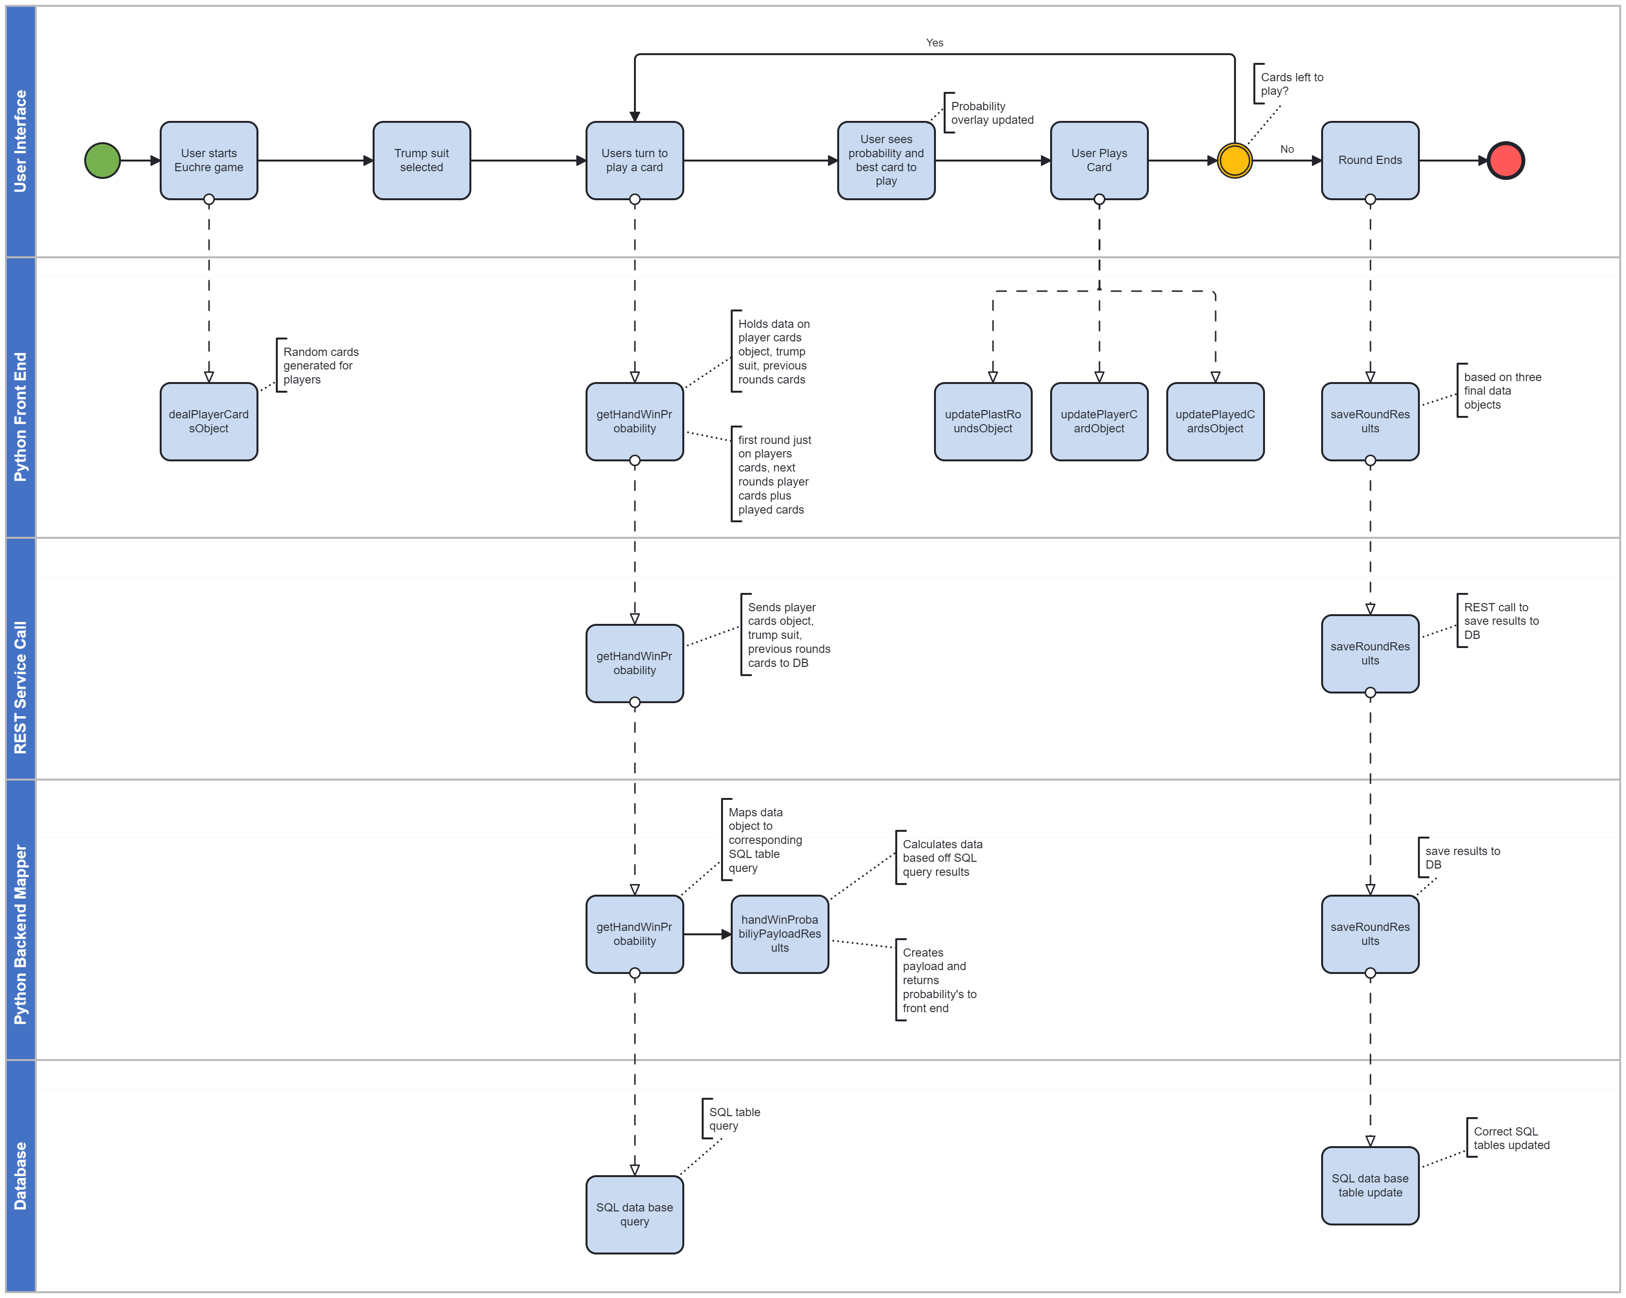
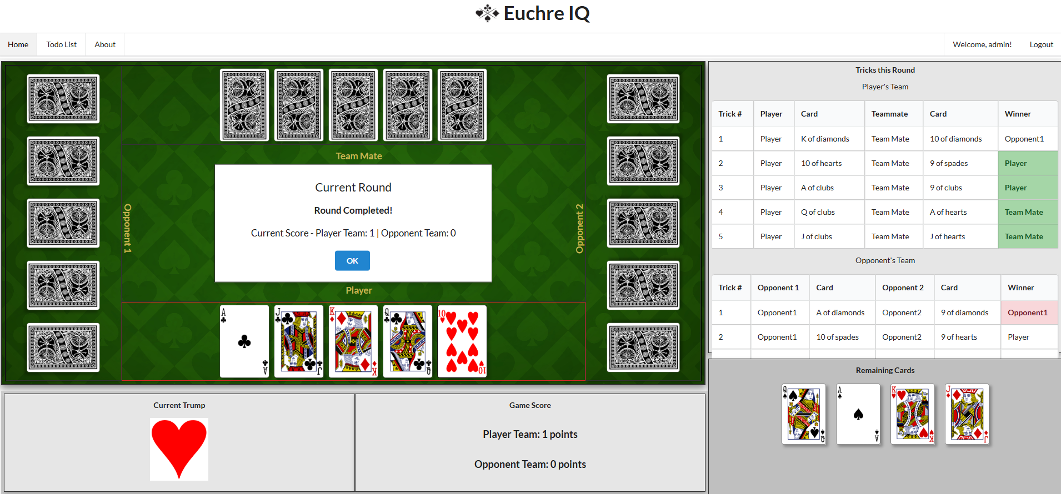







Project Overview
Play Euchre
Advisor:
Fred Annexstein
Professor CEAS
Team Members:
Simon Feist
Computer Science
Gabriel Imes
Computer Science
Travis Hurst
Computer Science
Background
Design Decisions
-----------------------------------------------------------------------------------------------------------------------------------------
Euchre can be an intimidating game for new players, and its popularity can vary greatly between regions
This application could be used to both help new players learn the basic rules of Euchre as well as help advanced players discover new strategies
Could there be new strategies or insights gained from statistically reviewing the data from many games of Euchre?
Will there be a great difference in this data between AI and human played games?
Game service calls needed to be structured in a way that allowed the data to be returned at the Player's turn
This will give the most up-to-date game state, and return everything necessary for our data overlays to the Player
When the round ends all data will be sent back server-side SQLite on local, PostgreSQL when deployed
Goals
Data analytics will be shown for chances of team winning the round, will update after each trick
Insights will be based off the user’s hand
Use bot to simulate large data set of automated games to accurately predict the right decision
Challenges
--------------------------------------------------------------------------------------------------------------------------------------
Learning a new Python framework and technologies
Creating an accurate data model which can be used to both automate player moves and for statistical analysis
Giving the manual game mode a good user experience
What's Next
More advanced and accurate overlays
Analyze differences in playstyle between manually played games, and auto games used for data collection
Tune hyperparameters in Montecarlo and RandomForest simulations for more accurate results
When logged in, User can view a unique dashboard which shows past games, and statistics on how their play has improved over time
Achievements
--------------------------------------------------------------------------------------------------------------------------------------
Created and deployed Django framework, Python based web application on the front-end
Successful data collection on Euchre games using Montecarlo simulations and data analysis using the RandomForest algorithm with both manual and automatic play, uploaded to SQL database server side
Created procedures to have effective source control using GitLab, gitignore, and VS code. This allowed us to be very efficient as a team.
-----------------------------------------------------------------------------------------------------------------------------------------------------------------------------------------
Technologies

